Slide 1
Gold Claim Case
By Peter & Jack

Slide 2
Problem Statement
Grant Murphy has hired his friend Andrew McKendry to evaluate gold claims
Murphy is interested in the possibility of developing the claims
Renewed gold prices and advancements in technology has renewed interest in developing the area
To start mining, Murphy needs to do the following:
Build a permanent road to the area
Perform an exploratory drill to see if gold can be feasibly mined
Note that a permanent road isn`t necessary for exploratory drilling
Objective is to determine the most economical option for Murphy

Slide 3
Assumptions
Assume the Specific Gravity is uniformly distributed
Assume estimates for distance, cost, as well as success probability for both permanent road and diamond drilling are uniformly distributed
Assume the length, width, and depth are normally distributed
Assume historical-based triangular distribution for 2009-2010 gold prices
Possibility of a concrete trend for gold prices will be explored in sensitivity analysis
Assume no storage is possible
Any gold that is mined will be immediately sold based on market price at the time
Assume ice road has no build time or cost
Assume diamond drilling has negligible lead time
Assume drilling and road costs are paid during year 0
Assume first cash flow will arrive at end of year 1
Assume the ice road will always be built first since Murphy would wait until the results of diamond drilling

Slide 4
Model Development (Pt. 1)
Normal distribution numbers for vein width, depth, length, and grade of gold vein
 | Width | Depth | Length | grade
Avg min | 5.75 | 32.7 | 79 | 0.927
Avg max | 10.75 | 50.4 | 102 | 4.373
μ | 8.25 | 41.6 | 90.5 | 2.65
σ | 0.833 | 2.933 | 3.833 | 0.574

Slide 5
Model Development (Pt. 2)
Uniform distribution parameters
 | Specific Gravity | Road Distance | Road Cost | Road Success Prob. | Drill Length | Drill Cost | Drill Success Prob.
Min | 3.4 | 2.5 | 6000 | 49% | 2500 | 21 | 32%
Max | 4.8 | 7.5 | 14000 | 91% | 7500 | 39 | 100%

Slide 6


Model Development (Pt. 3)
The various parameters from the previous 2 charts are fed into a SIMUL8 model in order to accurately determine probabilities
Gold cash flows are determined by the equation given in the case
For present value (PV), substitute cash flow for a given year into C1, use 20% as r, and year number is n
For entire 10-year period’s total cash flow, sum up cash flow as follows:

Slide 7
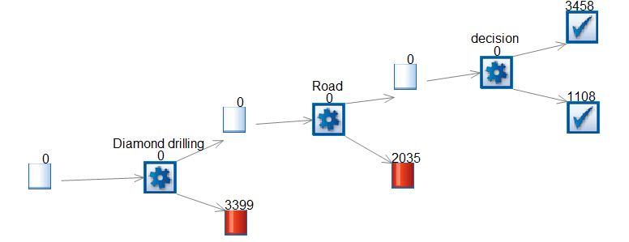
Model Development (Pt. 3)

Slide 8
Base Solution
Performed 10 runs of 10,000 samples through SIMUL8
33.72% chance of diamond drilling failing with confidence interval of (33.3%, 34.15%)
19.85% of permanent road failing with confidence interval of (18.82%, 20.88%)
Probability of negative return (cost > revenue) is 11.18% with confidence interval of (10.83%, 11.43%)
Probability of profiting is 35.12% with confidence interval of (33.94%, 36.3%)
All confidence intervals are within 95%
Due to nature of SIMUL8, we were unable to obtain actual revenue
Recommend Murphy to go ahead with development

Slide 9
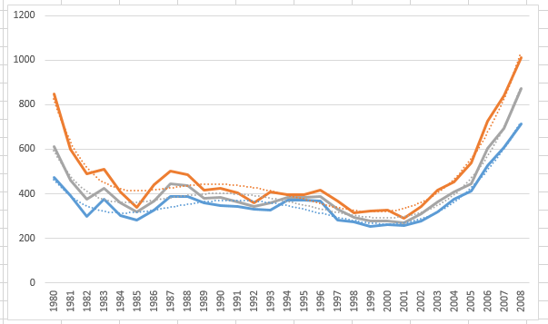
Sensitivity Analysis (Pt. 1)
Gold prices have trend instead of be triangularly distributed
Trial-and-error indicates that a 6th-order polynomial distribution is best fit for gold prices over the years (see dotted lines for projections)

Slide 10
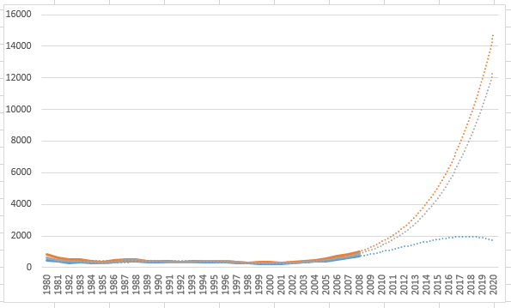
Sensitivity Analysis (Pt. 2)
The polynomial regression was extended for 10 years to forecast future gold prices
Visual inspection is sufficient to determine that the projected cash flow would be much higher than using triangular distribution to select existing gold prices

Slide 11
Conclusion
Recommend Murphy to go ahead with development
Sensitivity analysis reveals that attempting to forecast gold price would yield extremely high future prices
This would give even more incentive for Murphy to develop as it increases likelihood of the gold claim having positive returns

